Slide 1
Defence Infrastructure Delivery
Northern Territory

Slide 2
Forward Works Program
Major Projects | FY 21/22 | FY 22/23 |  | FY 23/24 | FY 24/25 | FY 25/26 | FY 26/27 | FY 27/28
AIR7000 Ph2B P-8A Poseidon | $162m (RAAF Darwin)
Larrakeyah Redevelopment | $520m (Larrakeyah / Coonawarra)
SEA 1180 Offshore Patrol Vessels | $245m HMAS Coonawarra & RAAF Darwin (EO Storage)
RAAF Tindal Redev USFPI Airfield Works | $1,1b RAAF Base Tindal
USFPI NT Training Areas | $711m Robertson Barracks, Kangaroo Flats, Mt Bundy, Bradshaw
AIR7000 PH 1B MQ-4C Triton | $147m RAAF Base Tindal
USFPI Robertson Base Infrastructure |  | $339m Robertson Barracks
RAAF Darwin Mid-term Refresh |  |  | $148m RAAF Darwin
National Airfields Capital Works |  |  |  |  | $180m RAAF Darwin / Mt Bundey
*Unapproved projects are indicative only and remain subject to Government 2nd Pass and Parliamentary Approvals

Slide 3
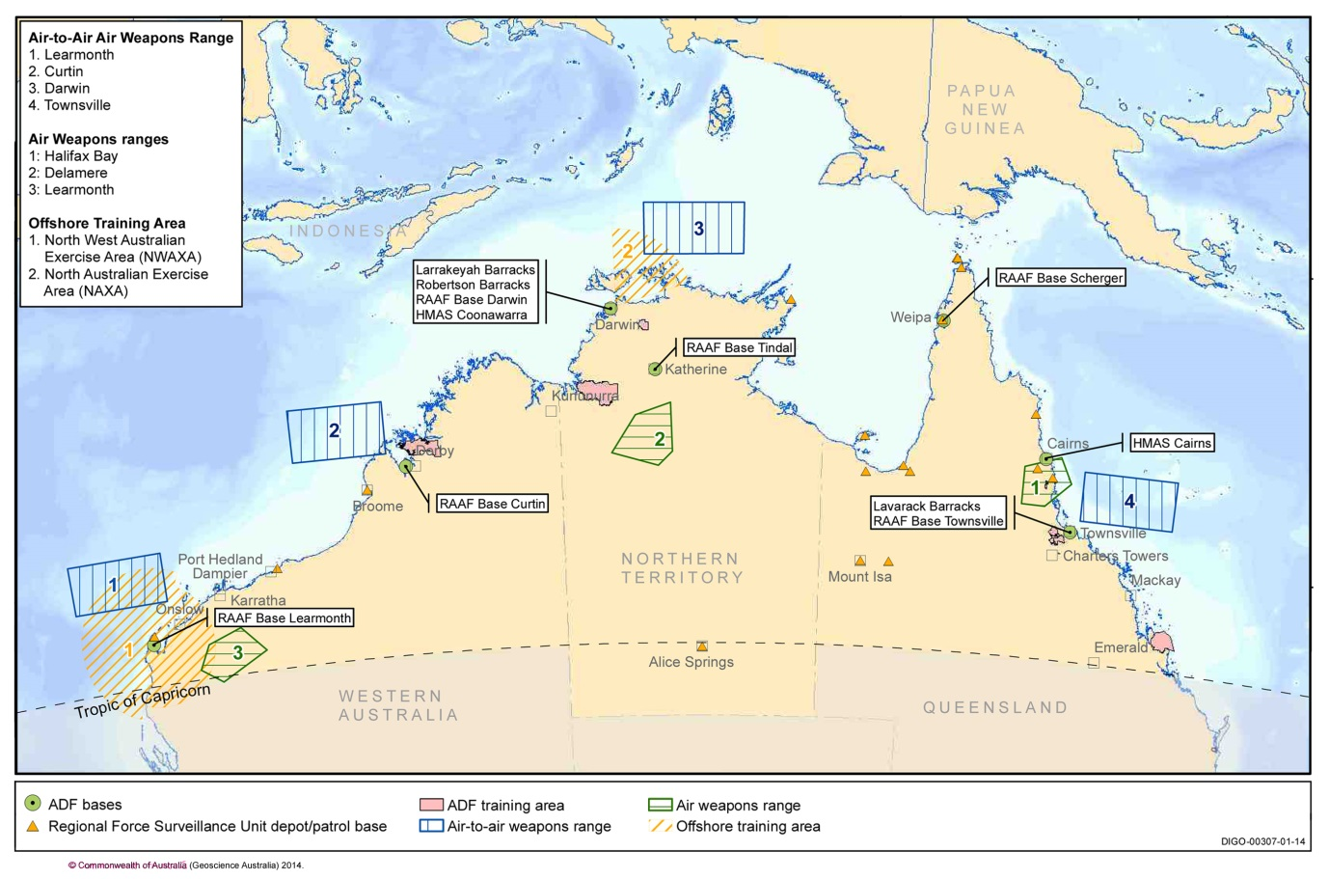
Defence Infrastructure in Northern Territory
Larrakeyah Defence Precinct
$520m Base Redevelopment
(Includes COVID Stimulus funding)
Status: Construction
Construction: Late 2018 – mid 2023
Contractor: Laing O’Rourke (MC)

Slide 4
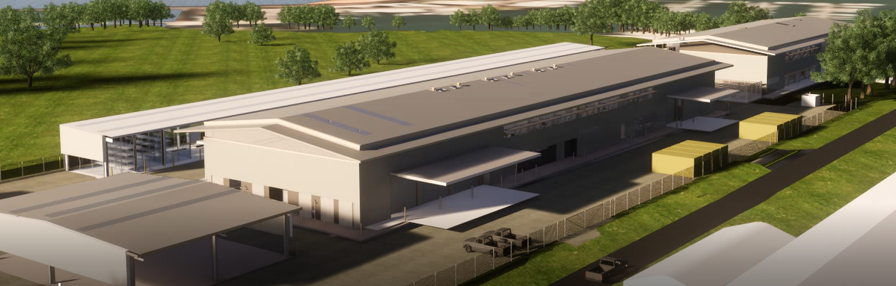
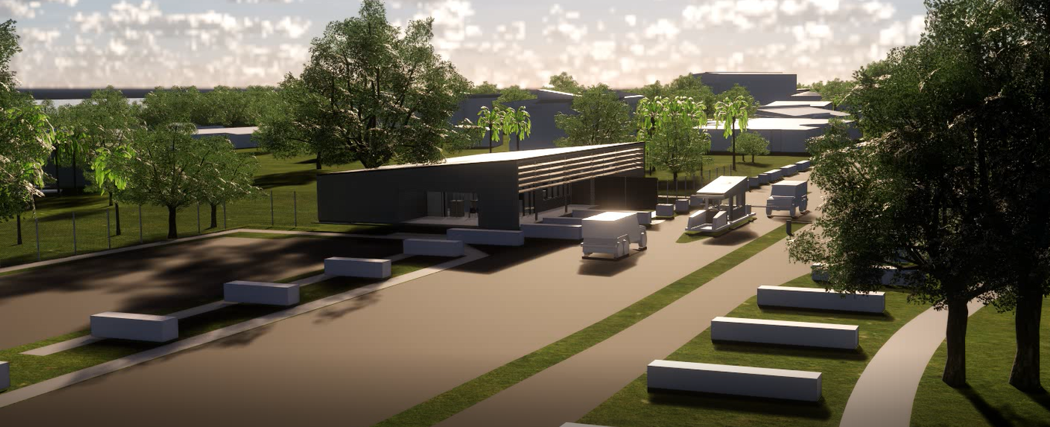
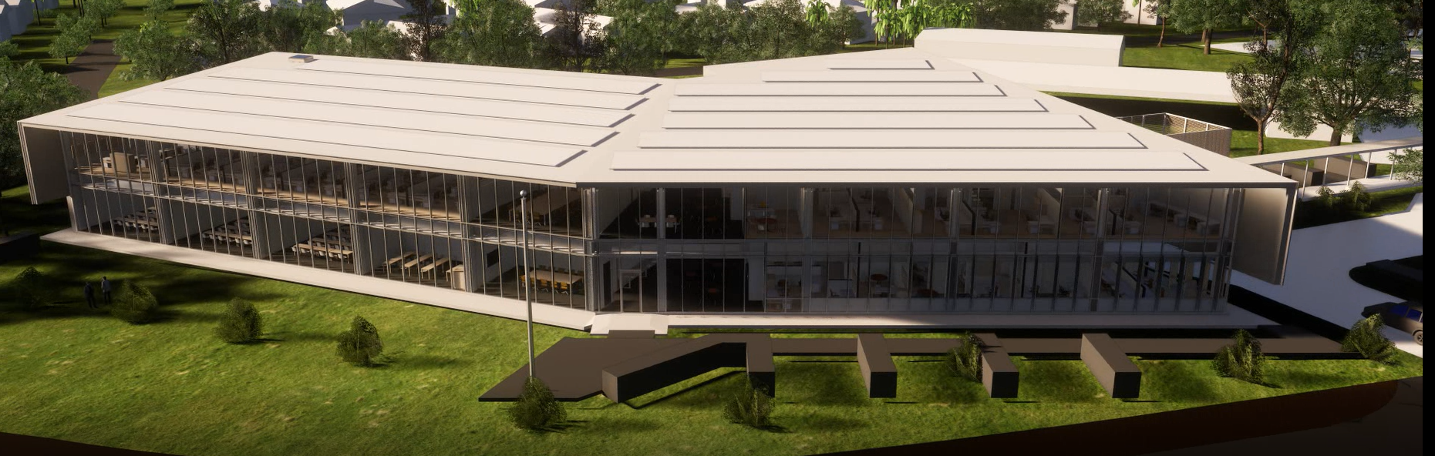
Larrakeyah Defence Precinct
New NORFORCE Facilities
New Base Entry Precinct
Shared User Facility

Slide 5
Defence Infrastructure in Northern Territory
HMAS Coonawarra
$245m SEA1180 Arafura Class OPV
Status: Design Construction: Early 2023– mid 2026
Contractor: NCIS-5 HC / NCIS-6 MC

Slide 6
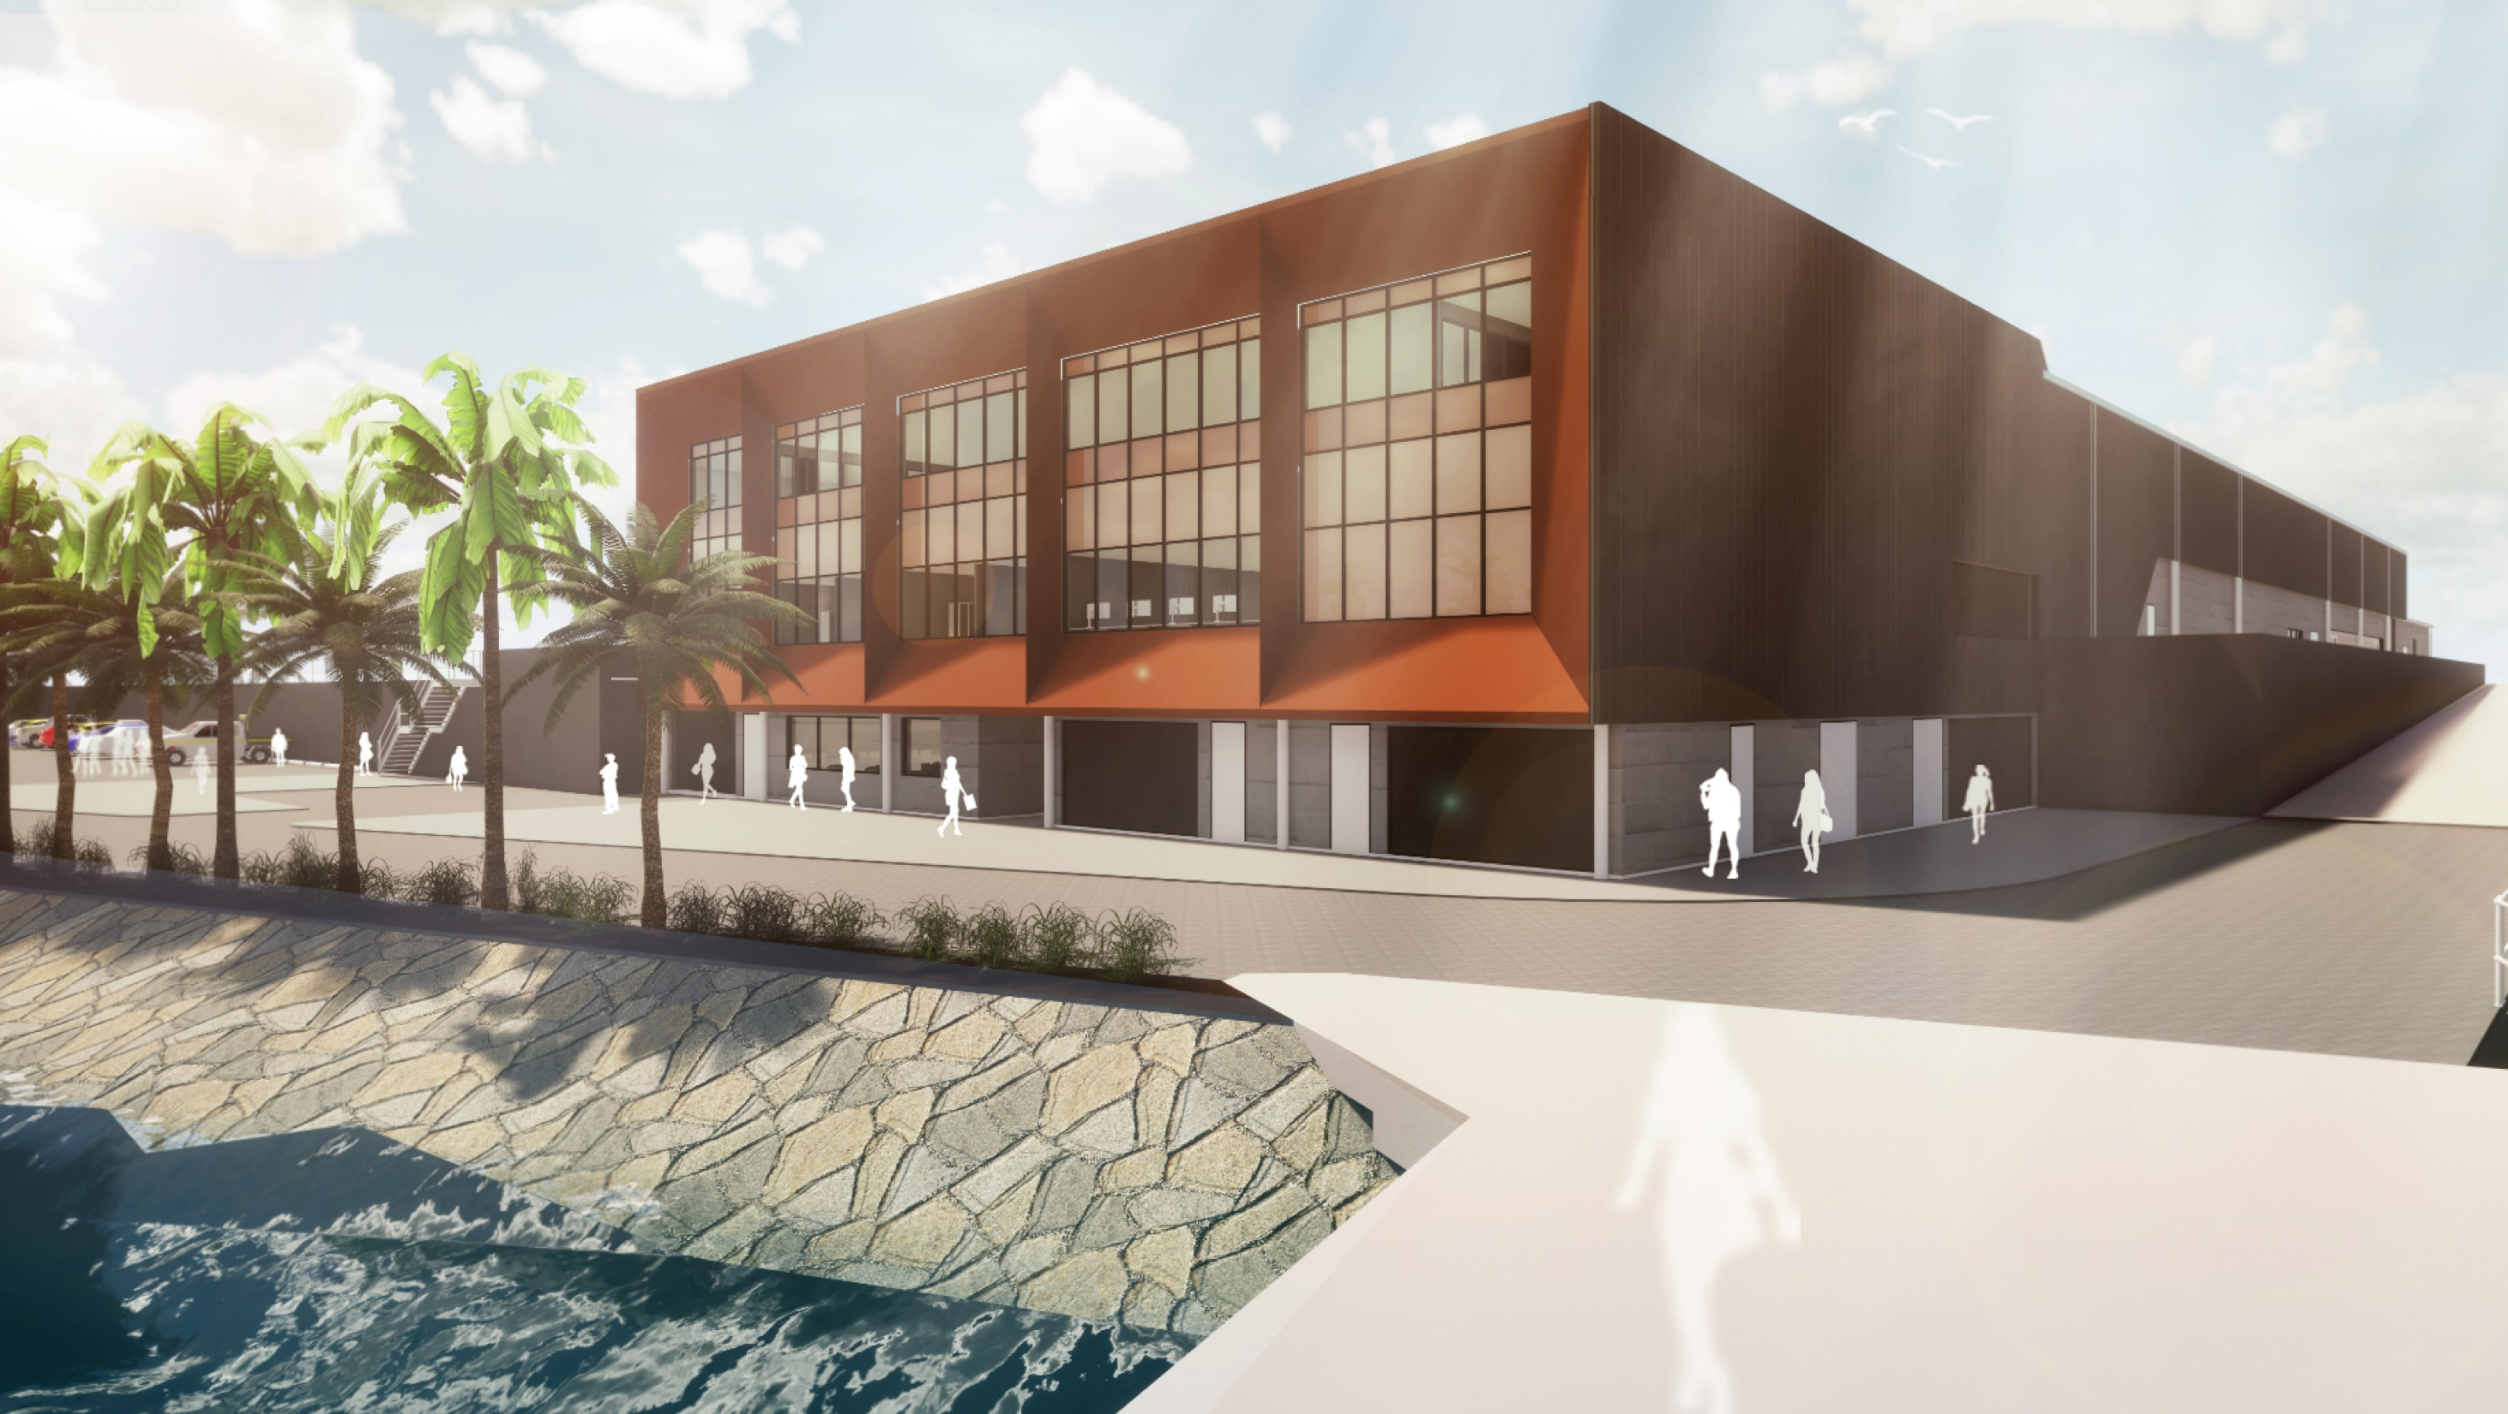
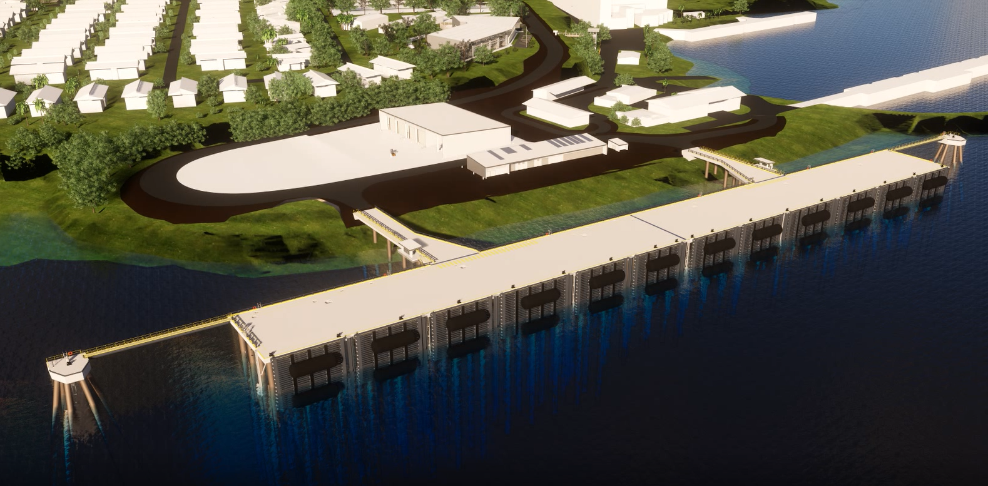
HMAS Coonawarra
FSNON Offshore Wharf
OPV Support Facility - North

Slide 7
RAAF Base Darwin
$162m AIR7000 Ph2B (P-8A FOB)
Status: Construction
Construction: 2019 - late 2022
Contractor: Sitzler (HC)

Slide 8
Defence Infrastructure in Northern Territory
RAAF Base Darwin
$148m Mid-term Refresh
Status: Development
Construction: Mid 2023 – mid 2025
Contractor: TBC (MC)

Slide 9
Defence Infrastructure in Northern Territory
RAAF Base Darwin & Mt Bundey
$180m National Airfields Works
Status: Planning
Construction: 2025-2027
Contractor: TBC

Slide 10
Defence Infrastructure in Northern Territory
RAAF Base Tindal
$1.1bn Redevelopment/Airfield Wks
Status: Construction
Construction: Sep 2020 – end 2027
Contractor: Lendlease (MC)

Slide 11
Defence Infrastructure in Northern Territory
RAAF Base Tindal
$147m AIR7000 Ph1B (MQ-4C FOB)
Status: Design / Approvals
Construction: Q4 2022 – end 2025
Contractor: TBC (HC)

Slide 12
Defence Infrastructure in Northern Territory
NT Training Areas & Ranges
$711m USFPI range upgrades
Status: Construction
Construction: Oct 2021 – mid 2026
Contractor: Sitzler (MC)

Slide 13
Defence Infrastructure in Northern Territory
Robertson Barracks
$339m Base Support Infrastructure
Status: Design Development
Construction: Early 2023– end 2025
Contractor: TBC

Slide 14

Defence Infrastructure in Northern Australia
Defence COVID-19 NT Stimulus Initiatives
Around $190 million in additional works are planned be delivered across several existing projects over the next two Financial Years:
$31 million at Larrakeyah Barracks for a new Gymnasium and Mess Refurbishment
$10 million for a Maritime Security Training Centre at HMAS Coonawarra
$7.5 million Explosive Ordinance Storage Facility at RAAF Darwin to support the Offshore Patrol vessels
$18 million for new Garrison Health Facility at RAAF Darwin
$2 million to complete the Small Arms Range Complex at Robertson Barracks
$121.5 million at Delamere Air Weapons Range for additional works to support the Growler aircraft.

